Slide 1

Change in the Functional Space of Angiosperms in the Marquesas Islands “When new data changes an old story”
BY PRANJEL

Slide 2
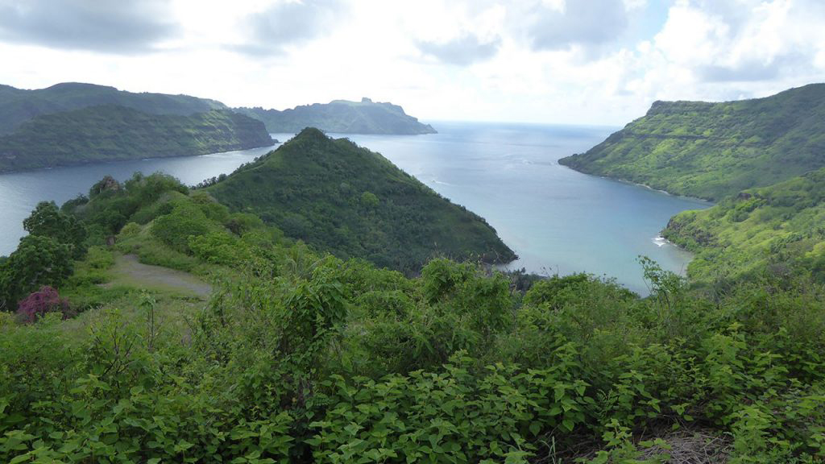
Hypothesis
“The new Flora of the Marquesas Islands, by adding missing species and trait information, will expand and reshape the functional trait space of Marquesas vascular plants.”

Slide 3
THE WHY?

Slide 4

Why does this question Matters
We study biodiversity using large trait databases.
But many of them are incomplete or contain errors.
Each update can actually change ecological conclusions.

Slide 5
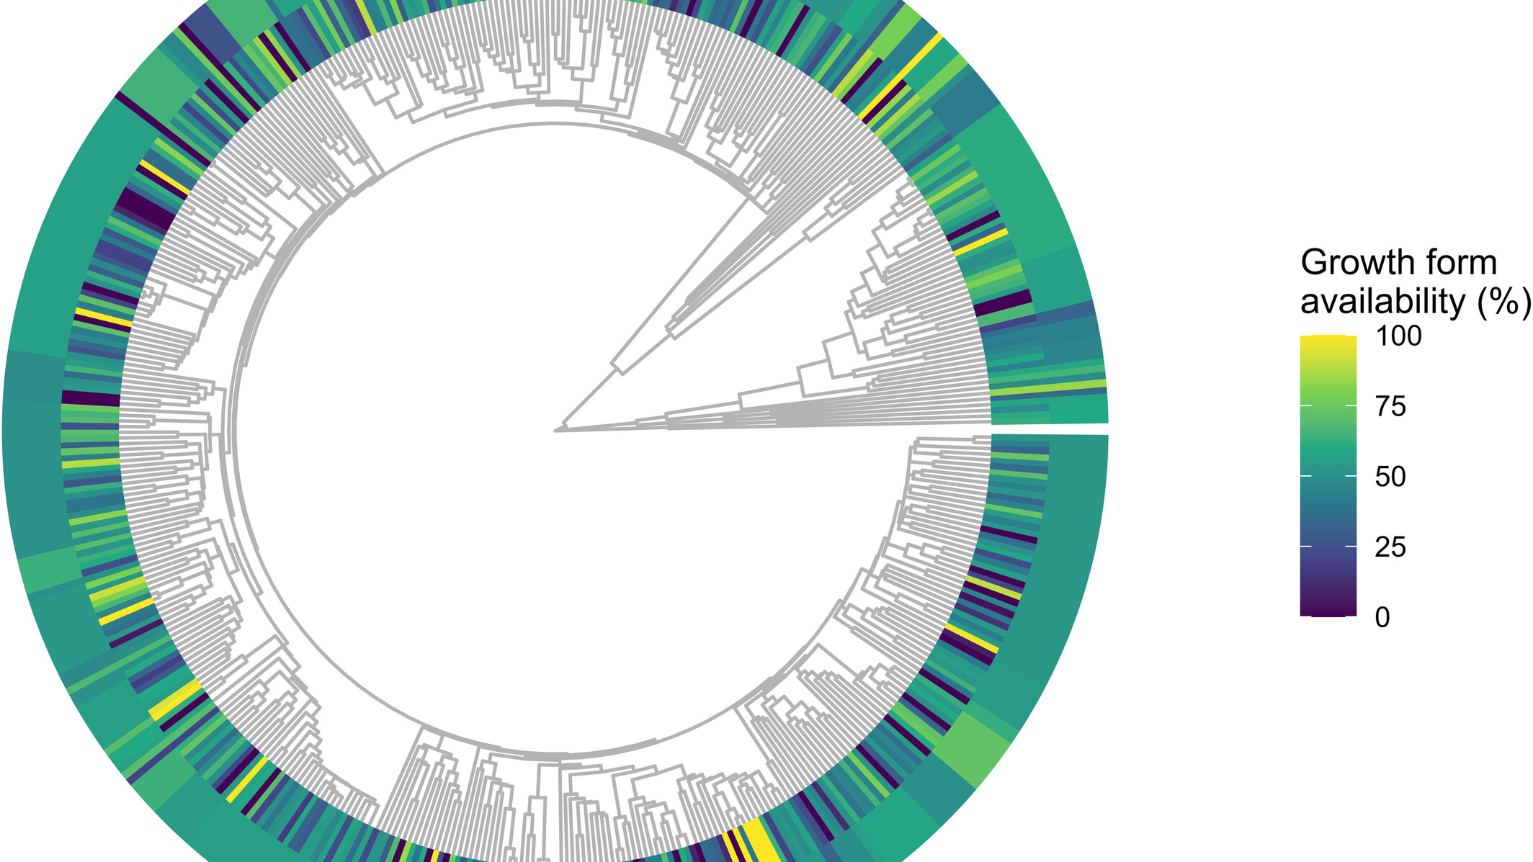
The GIFT database
GIFT = Global Inventory of Floras and Traits.
300,000+ species, 83 traits, global coverage.
Combines species lists, traits, environment.

Slide 6
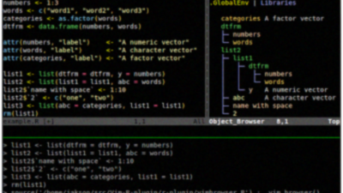
Accessing GIFT via R
R package GIFT (Denelle 2023).
Helps extract data easily for any region.
I’ll use it to get the older Marquesas dataset.

Slide 7
THE PROBLEM

Slide 8
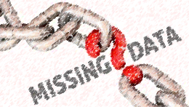
The Missing Data Problem
Many plants have unknown traits → Raunkiaerian shortfall.
Missing data = distorted analyses.
Example: shrubs often missing leaf data → bias.

Slide 9

The Data Error Problem
Global databases sometimes have inconsistencies.
Poor metadata, duplicated species, mixed units.
Data quality is key to reliable results.

Slide 10
THE STUDY SYSTEM

Slide 11
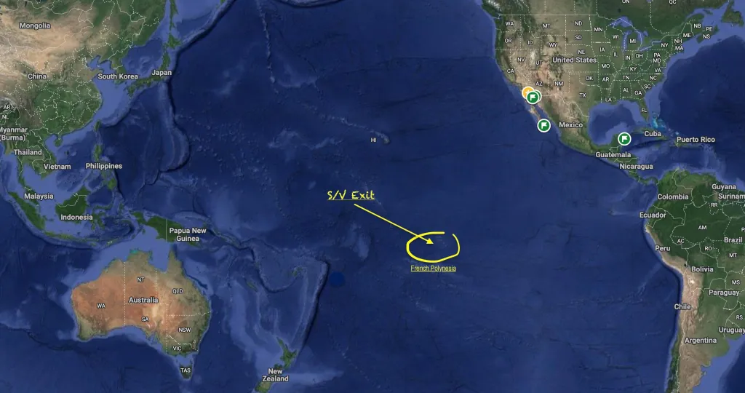
The Marquesas Islands
Volcanic island group in French Polynesia.
Extremely remote, many unique endemic species.
Perfect for studying isolated biodiversity

Slide 12
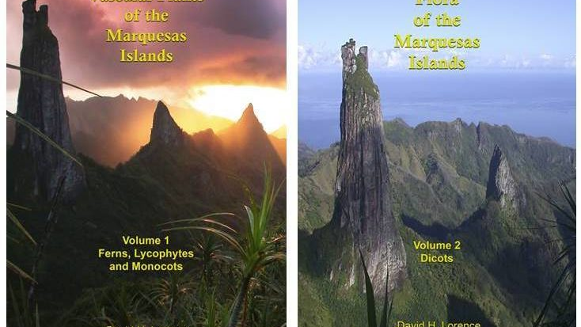
The New Flora Book
Flora of the Marquesas Islands, Vol. 2 (2020) adds missing dicots.
Describes growth form, leaves, flowers, fruits, and habitats.
Published by the National Tropical Botanical Garden.

Slide 13
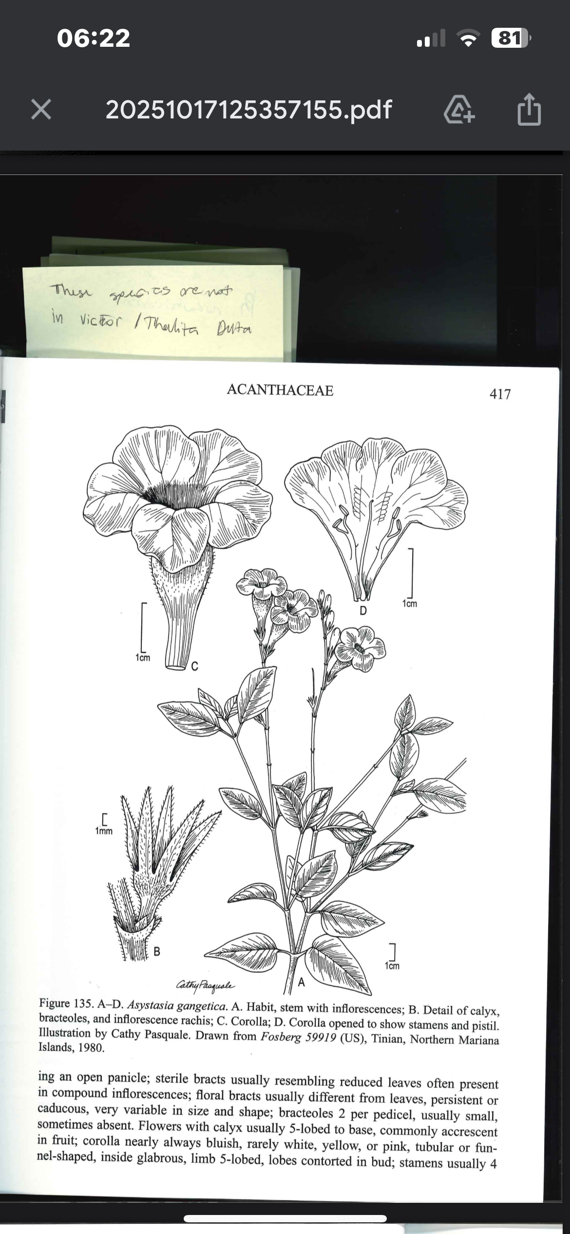
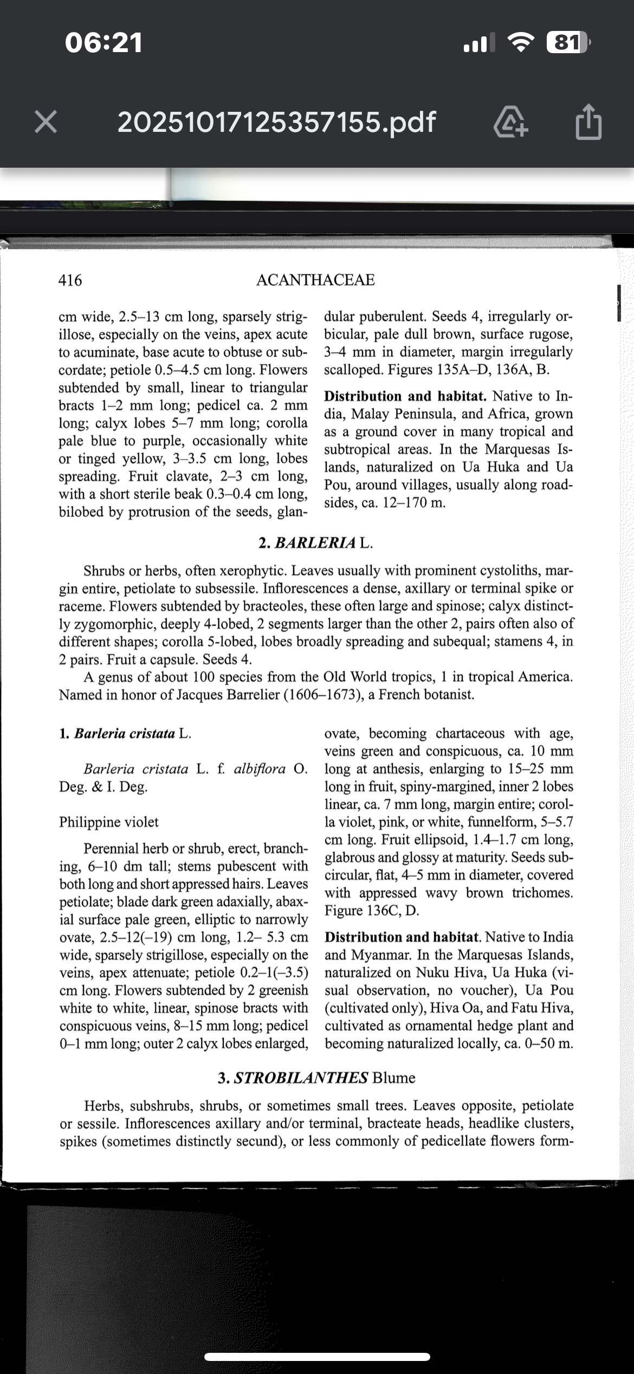

Slide 14
What’s Already in GIFT?
Partial data from previous publications.
Some species missing traits or entries.
New flora adds missing dicots and traits.

Slide 15
The Core Concepts

Slide 16
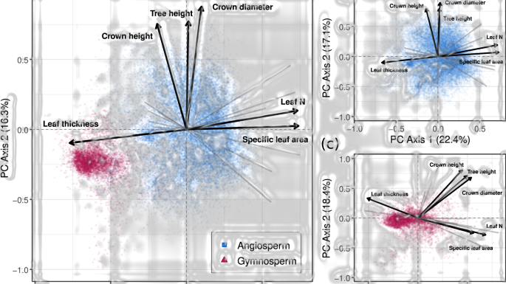
What is a Functional Trait?
A measurable feature that influences survival or reproduction.
Examples: plant height, seed size, leaf area, wood density.

Slide 17
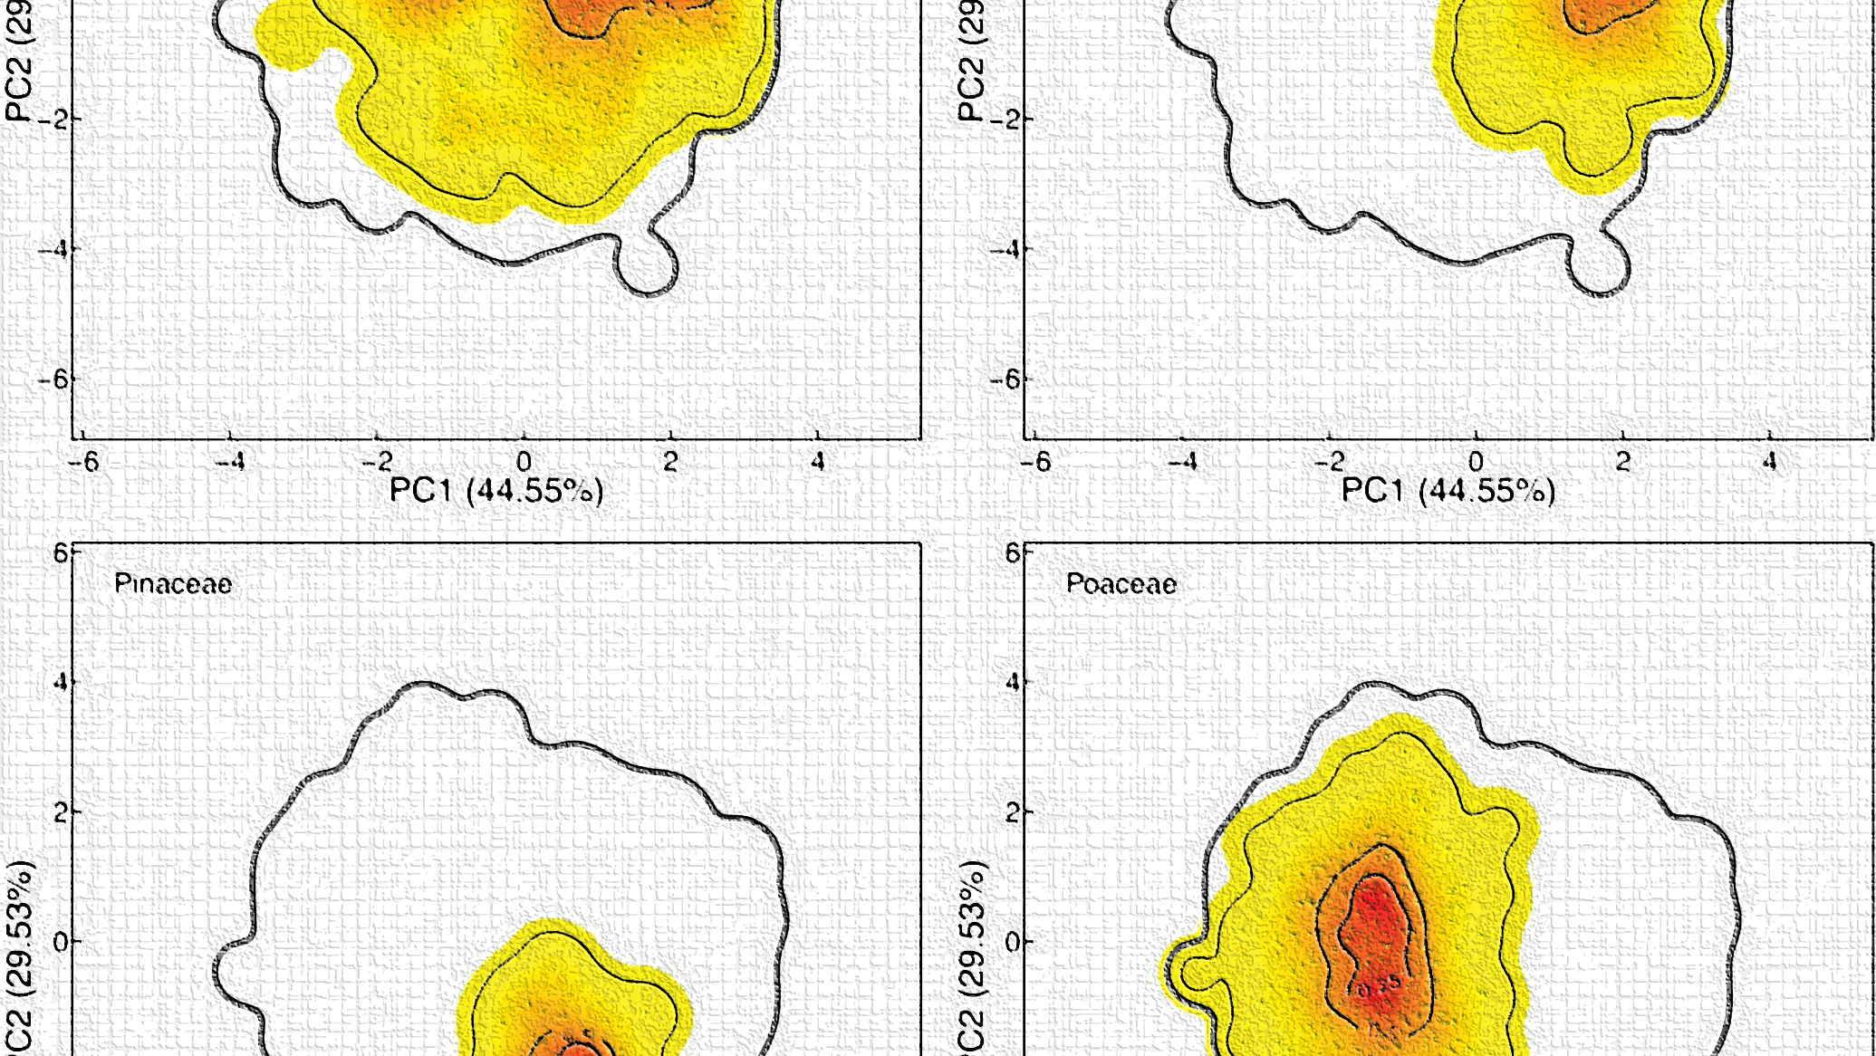
What is Functional Space?
Each species = a dot based on its traits.
All dots together = functional space (the “cloud”).
Big cloud = many strategies; small cloud = few.

Slide 18

How Can Data Change the Space?
Add missing species → new dots → bigger cloud.
Correct trait values → shift or reshape cloud.

Slide 19
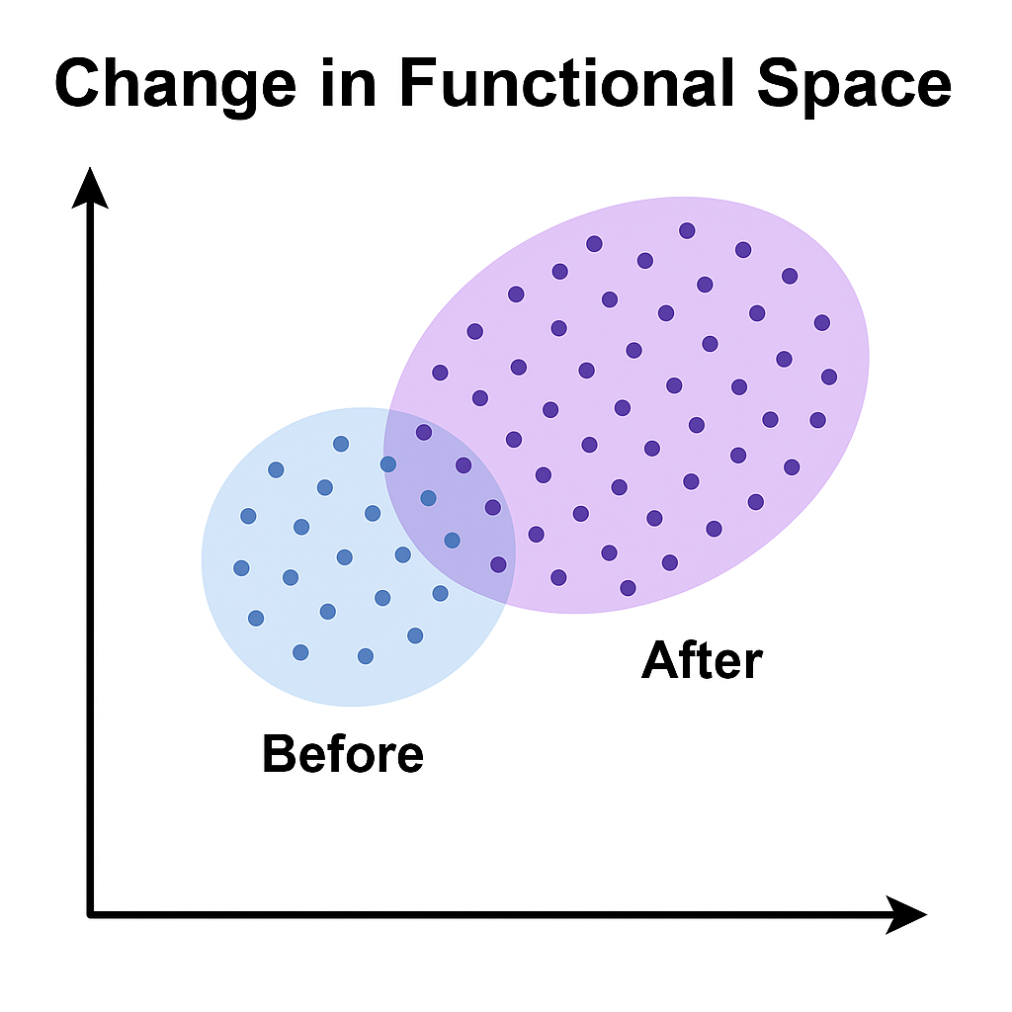

FIGURE 1
FIGURE 2

Slide 20
The Plan

Slide 21

My Workflow
Extract old Marquesas data from GIFT
Collect new species/traits from Flora
Merge & clean in Excel/R
Build trait space using funspace
Compare before vs after.

Slide 22
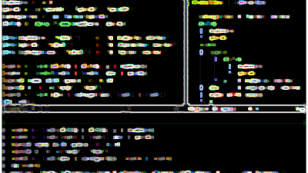
The Tools
R Script: Get_species_and_traits.R (from Isis)
Downloads current GIFT data for Marquesas
Lists species and trait coverage
Flora book: adds missing species and trait descriptions
Excel: for cleaning and merging

Slide 23
What I Expect to Find
Larger functional richness (FRic)
Better coverage of life forms
Possibly new clusters of traits
Improved completeness of GIFT data

Slide 24
The Significance & Big Picture

Slide 25
Why This Project Matters
Improves data quality in GIFT.
Shows how updates can shift ecological interpretations.
Provides new insights into island biodiversity and endemism

Slide 26
References
1] Weigelt et al. (2020) – GIFT database 2] Denelle et al. (2023) – GIFT R package 3] Hortal et al. (2015) – Raunkiaerian shortfall 4] Augustine et al. (2024) – Data quality issues 5] Hembry (2018), Price & Wagner (2011) – Marquesas biodiversity 6] Lorence & Wagner (2020) – Flora of the Marquesas Islands 7] Carmona et al. (2024) – funspace R packagea.

Slide 27
Acknowledgements
Dr. Isis and the GIFT team
Holger Kreft, Göttingen University
Authors of the Flora of the Marquesas Islands
National Tropical Botanical Garden

Slide 28


